Slide 1
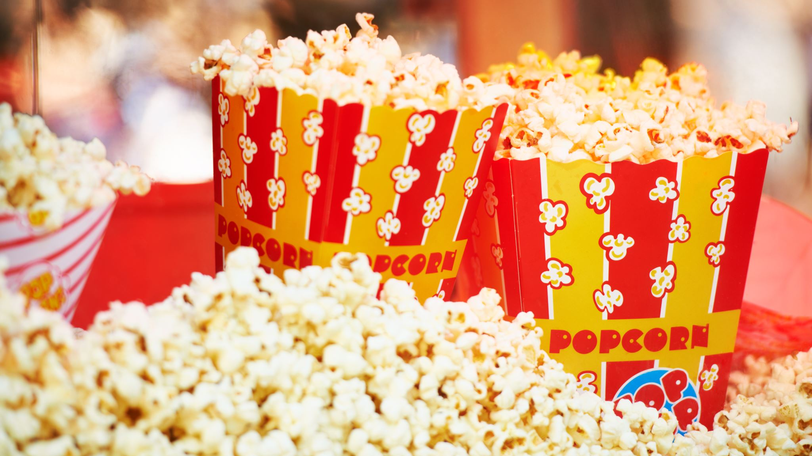
Into the Movies
Jumanji: Welcome to the Jungle

Slide 2
Welcome to the Jungle
Watch the trailer to the movie : Jumanji – Welcome to the Jungle using the link below
https://www.youtube.com/watch?v=2QKg5SZ_35I
As a youth group, most of us have watched the movie so today we will look at how some of the themes in the film link to Biblical themes.

Slide 3
Create your own avatar
In the film Jumanji the characters become Avatars with strengths and weaknesses these are both real and silly. One of the weaknesses is cake and one of the strengths is smouldering intensity and fight dancing.
Design your own Avatar with some serious and creative strengths and weaknesses. You could even have some fun creating names and outfits for your Avatars.
You may want to draw out, describe or create a model of your avatar. You can even send in your pictures to youthteam@westcroydon.com

Slide 4
Identity Developing
Throughout the movie Jumanji the characters wrestle with who they are in the game and who they are in real life.
One character, played by Jack Black, in particular struggles with the fact that she is transformed into a middle-aged science nerd when in real life she is a cheerleader. During the film she becomes more and more comfortable with who she is inside and outside of the game. She even develops a more positive body image through the story.
Discuss with a friend or parent of times when you find it difficult to be yourself. Do you have any behaviours that you do to cover up that you are uncomfortable?

Slide 5
1 Samuel 16:7
Read the following verse and answer the discussion questions with a parent or carer:
But the Lord said to Samuel, “Do not consider his appearance or his height, for I have rejected him. The Lord does not look at the things people look at. People look at the outward appearance, but the Lord looks at the heart.”

Slide 6
Discussion Questions
What does it mean to look at someone's heart?
How would the world be different if we saw people how God sees them - not their outward appearance but their heart?
Have you ever judged someone by how they look but then been surprised when you got to know them?

Slide 7
Stereotypes
In the beginning of the film, the characters could not be further from the common stereotypes of a ‘nerd’, ‘jock’, ‘cheerleader’ and ‘angry girl’.
Think about a time when they have stereotyped someone and then found out that they were wrong or confused in the way that they treated them……
You are not the only one to have thought or behaved in a stereotypical way, and God is gracious and kind and will help us to change our attitudes.

Slide 8
1 Corinthians 12: 12-27
Read through 1 Corinthians 12:12 -27 with a parent, carer or on your own. I have included some parts below
12 Just as a body, though one, has many parts, but all its many parts form one body, so it is with Christ. 13 For we were all baptized by one Spirit so as to form one body—whether Jews or Gentiles, slave or free—and we were all given the one Spirit to drink. 14 Even so the body is not made up of one part but of many.
24 ……..But God has put the body together, giving greater honor to the parts that lacked it, 25 so that there should be no division in the body, but that its parts should have equal concern for each other. 26 If one part suffers, every part suffers with it; if one part is honored, every part rejoices with it.
27 Now you are the body of Christ, and each one of you is a part of it.

Slide 9
Discussion Questions
Did God design everyone to be the same? If not, why not?
When someone is different to you, how could thinking of all Christians as being one body help how you see them?

Slide 10
One Life
When four students get detention in the film 'Jumanji: Welcome to the Jungle', Principal Bentley asks them to think about who they are and who they want to be. He says: "You get one life... You get to decide how you're going to spend it".
You may want to write down some of you answers
Who are you?
Who do you want to be?
What do you need to change to become who you want to be?
How will you change those things and who can help you?

Slide 11
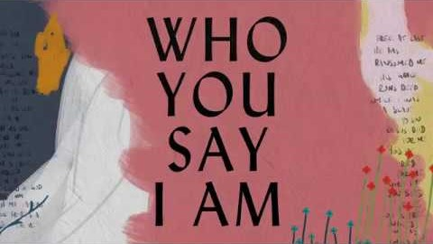
Sit Down and Listen
Reflect on today’s session. You may want to think about how you see yourself, how God sees you and how you see yourself in relation to other Christians.
Listen to Who You Say I Am - https://www.youtube.com/watch?v=IcC1Bp13n_4
Say a prayer to ask God to help you see who you are through his Word (the Bible)

